Slide 1
Anu Shenoy &
Eugene Rozhdestvensky
IBM Case Manager Client
September 4th 2014
Product Implementation Training (PIT)
IBM Case Manager 5.2.1
Using external documents in a case and as attachments

Slide 2
Introduction
Course Overview
  Use of external documents in a case and as attachments
Target Audience:
  L2, L3 support, GBS, GTS
Prerequisites:
  Familiarity with IBM Case Manager 5.2
Version Release Date Sept 2014
© Copyright International Business Machines Corporation 2013. All Rights Reserved.
US Government Users Restricted Rights - Use, duplication or disclosure restricted by GSA ADP Schedule Contract with IBM Corp.

Slide 3
Course Objectives
After this course you will be able to:
Understand how to work with documents from external repositories and add them to a case or as an attachment to a work item.

Slide 4
Course Roadmap
  External Documents Overview
    Configuring and using external repositories
    Enabling external repositories using Case Builder
  Adding external documents to a Case
  Working with external documents in a Case
  Using external documents as Attachments
  Known issues and trouble shooting guidelines
  Course Summary

Slide 5
External Documents: Overview
  What is an external document?
    An external document is an artifact that resides in an external repository.
    An external repository is an IBM Content Navigator repository that is different from the current Target Object Store.
Supported repository types
  IBM FileNet P8 (same domain such as DOS and cross-domain)
  IBM Content Manager V8.4.3 and V8.5 (CM8)
  IBM Content Manager OnDemand V9.0
  CMIS based repositories configurable via IBM Content Navigator
    Alfresco
    SharePoint
    FN-CMIS etc

Slide 6
External Documents: Overview
Case Manager 5.2 and below only supported documents from a single repository.
  In ICM on P8 environments, a case could only contain documents and folders from the current TOS.
  When enabled for CM8 integration, Case Manager supported documents from a single CM8 repository.
Case Manager 5.2.1 now supports using documents from multiple external repositories.
  External documents can be added to a case or as attachments to a work item
  All documents will continue to reside in the external repository
  Proxy document references are created in TOS and filed into the case
  Attachments will contain a reference to the original document ID

Slide 7
Course Roadmap
  External Documents Overview
    Configuring and using external repositories
    Enabling external repositories using Case Builder
  Adding external documents to a Case
  Working with external documents in a Case
  Using external documents as Attachments
  Known issues and trouble shooting guidelines
  Course Summary

Slide 8
Configuring and using external repositories
IBM Content Navigator Configuration
  All external repositories must be configured via IBM Content Navigator’s Administration desktop.
    http://<host>:<port>/navigator/?desktop=admin
  After the external repositories are configured, they must be added to the “Case Manager” desktop or “icm” desktop.

Slide 9
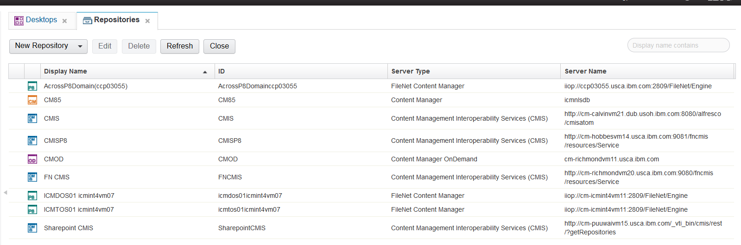
Configuring and using external repositories
  Configure external repositories via IBM Content Navigator’s Administration desktop.

Slide 10
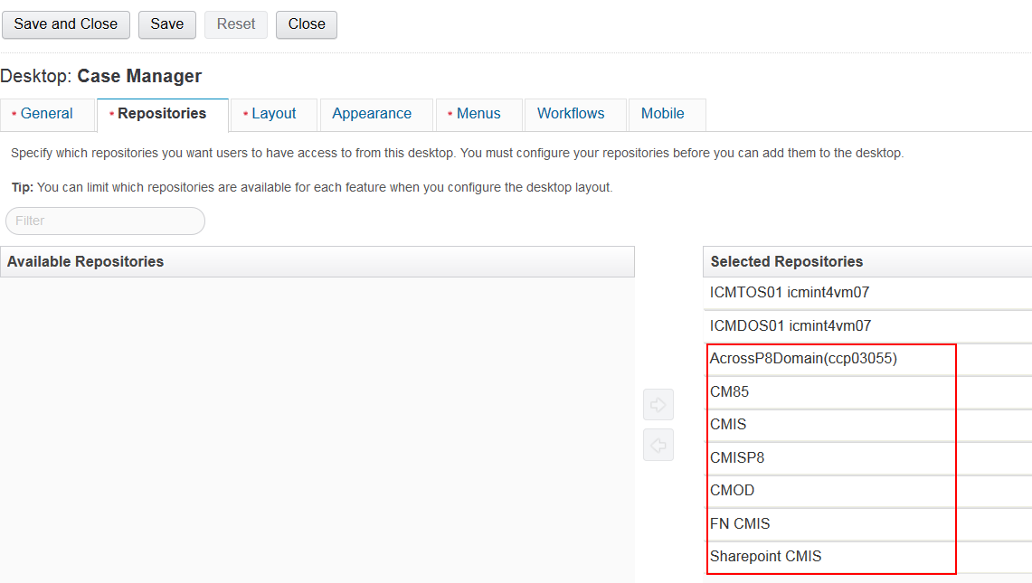
Configuring and using external repositories
Add external repositories to the “Case Manager” desktop or “icm” desktop

Slide 11
Configuring and using external repositories
Run one of the following tasks
  IBM Case Manager Configuration Tool
    Configure Case Management Object Stores task
  OR Case Manager Administration Client
    Update Object Stores task.
These tasks will create a database table in the Case Manager Target Object Store to store the proxy documents in P8
Details will be covered in PxT for Upgrade

Slide 12
Course Roadmap
  External Documents Overview
    Configuring and using external repositories
    Enabling external repositories using Case Builder
  Adding external documents to a Case
  Working with external documents in a Case
  Using external documents as Attachments
  Known issues and trouble shooting guidelines
  Course Summary

Slide 13
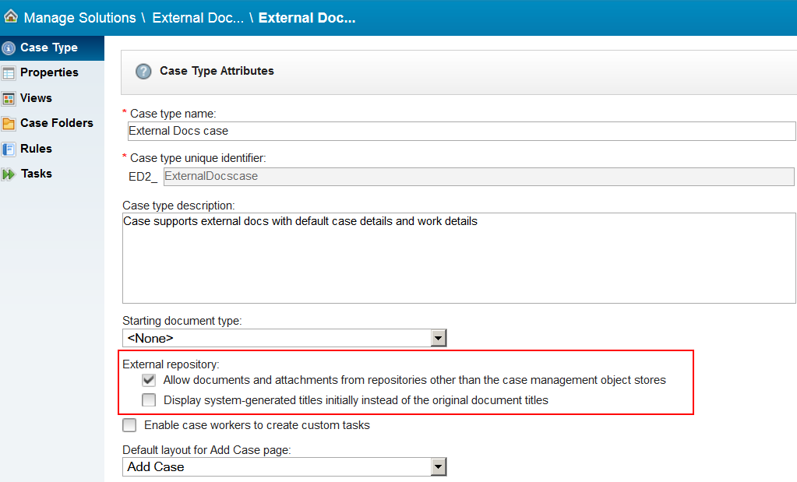
Case Builder: Enabling external repository support
Enable Case Types to support external documents
Do not use the original Document Title (unchecked by default)
Upper check box will affect dialogs used to add documents from repository and local system.
Once enabled user can select external repository to get document from or to save in.
Everything but TOS where case folder is found is external.

Slide 14
Course Roadmap
  External Documents Overview
    Configuring and using external repositories
    Enabling external repositories using Case Builder
  Adding external documents to a Case
  Working with external documents in a Case
  Using external documents as Attachments
  Known issues and trouble shooting guidelines
  Course Summary

Slide 15
Adding external documents to a Case
External documents can be added to a case by
  Selecting one or more existing documents from an external repository and filing them into the case
  Uploading a document from the case worker’s local file system to an external repository that supports Add Document and filing the newly added document into a case
A proxy document with the following information is created in P8 for each selected external document that is filed into the case folder
  Document ID of the external document
  Document title (only if the “Display system generated title” checkbox has not been checked in Case Builder)
  Server connection information to access the document

Slide 16
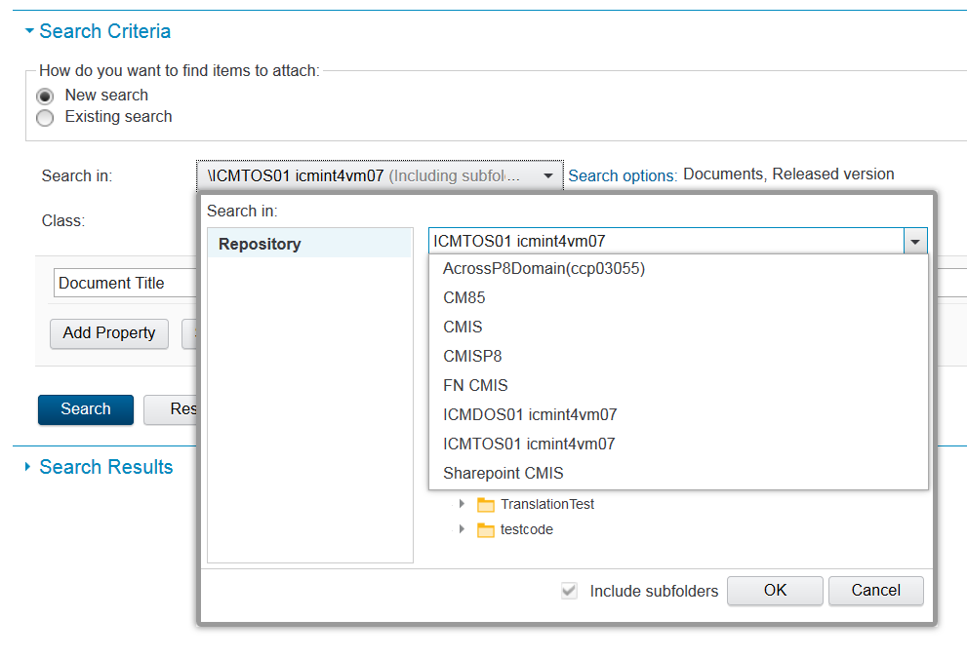
Adding external documents to a Case
Selecting documents from external repositories
  New searches can be defined for P8, CM8 and CMIS repositories
  CMOD only supports cross repository searches pre-defined using IBM Content Navigator Search builder.

Slide 17
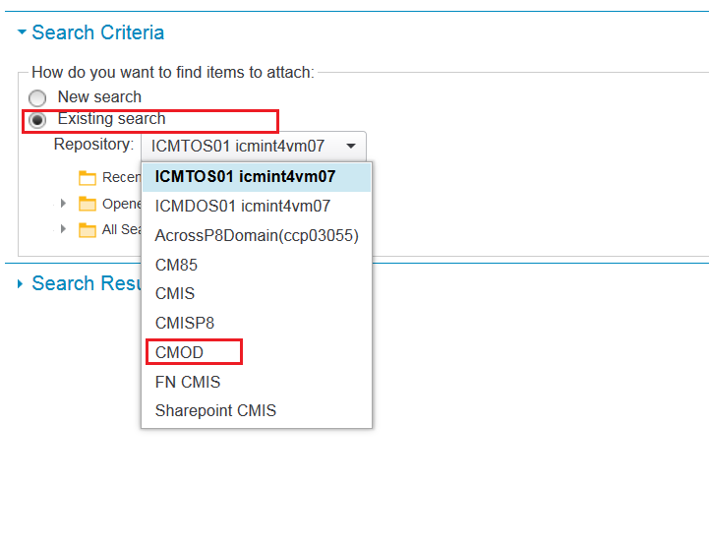
Adding external documents to a Case
Selecting documents from external repositories
  Only existing cross-repository searches pre-defined using IBM Content Navigator can be used to search CMOD repositories.

Slide 18
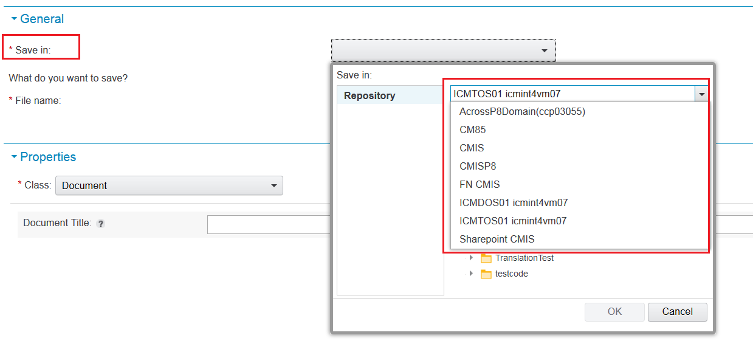
Adding external documents to a Case
Uploading a document from a local file system to an external repository
  Save in field is now displayed in the Add document dialog
  List of repositories displayed are P8, CM8 and CMIS
  CMOD does not support document ingestion via this dialog. Documents are ingested into CMOD via bulk loading or using the command line data loading and indexing tool ARSLOAD.

Slide 19
Course Roadmap
  External Documents Overview
    Configuring and using external repositories
    Enabling external repositories using Case Builder
  Adding external documents to a Case
  Working with external documents in a Case
  Using external documents as Attachments
  Known issues and trouble shooting guidelines
  Course Summary

Slide 20
Working with external documents in a Case
External documents are displayed in the “Documents” tab of the Case Information widget along with other P8 documents.
On initial rendering and on refresh operations, the document is represented with a generic mime type icon identifying it is external.
On selecting the row corresponding to the external document, the actual document information and content are retrieved and updated in the Documents list. This includes:
  Updated mime type
  Updated locked status
  Updated information
Note: On selecting the row, the case worker is prompted to login to the external repository if the external server is not configured for Single Sign-on. And the row is updated only if the logged in user has the right privileges to access the document. All privilege checks are made against that repository.

Slide 21
Working with external documents in a Case
After the document is retrieved and the row is updated, the context menu for the actual document gets enabled.
The context menu actions that display are based on the selected document and its repository type
  E.g. A document from a CMOD repository will not cause the Check in/Check out and versioning related actions to be enabled
Some actions are followed by a refresh on the current folder. The refresh operation resets the external document state to that of the proxy.

Slide 22
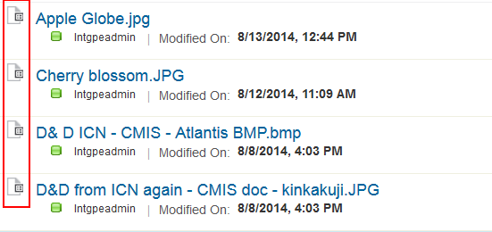
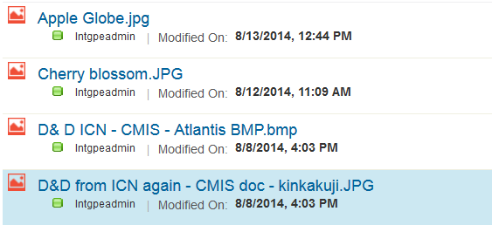
Working with external documents in a Case
External documents are displayed with generic mime type icon (on the left)
More details added after selecting the row

Slide 23
Course Roadmap
  External Documents Overview
    Configuring and using external repositories
    Enabling external repositories using Case Builder
  Adding external documents to a Case
  Working with external documents in a Case
  Using external documents as Attachments
  Known issues and trouble shooting guidelines
  Course Summary

Slide 24
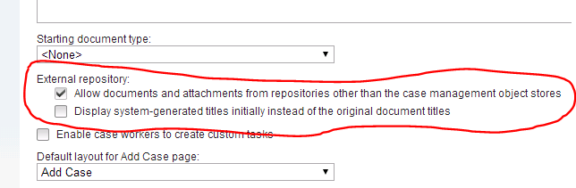
Using external documents as Attachments
Use the Attachment widget to attach documents from external repositories to a work item
Attachment widget functionality reflects the configuration applied to the case type in Case Builder
Users can attach documents directly from the external repository
Alternatively attach documents from the local system and save them in the external repository (with exception of CMOD)
Notes:
This looks pretty similar to what was stated for adding documents – are there any differences that should be highlighted?

Slide 25
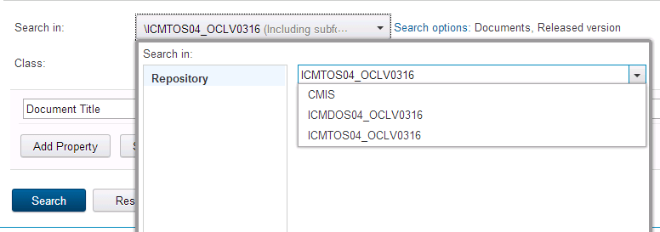
Using external documents as Attachments
When support for external documents is enabled users can select an external repository, CMIS in screenshot below. There will be a prompt to provide CMIS (or other external repository) credentials
Once external repository is selected steps to attach a document are the same as they would be for a repository that hosts case management object stores
Notes:
On the Add document slides, you noted that you can avoid the log in prompt by configuring SSO – is that not true for attachments?

Slide 26
Using external documents as Attachments
Unlike in the scenario when handling external case documents we don’t create a proxy that is saved in case folder. Attachment always references real document
There are still differences in handling external and “internal” attachments in the Attachment widget UI. These are explained in next slide
When user opens Work Detail page the Attachment widget may have to render UI to represent mix of documents, some from local repository and others from external ones which results in their different initial representation and allowed actions

Slide 27
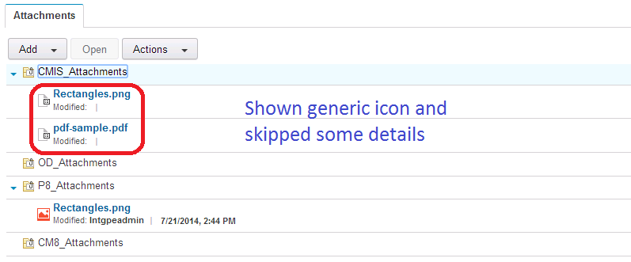
Using external documents as Attachments
When rendering the page the user is not prompted to enter credentials and log in to retrieve attachments from any external repositories
For this reason the resulting UI is incomplete like in the scenario related to case documents even though attachments don’t use proxies
Notes:
I changed the text, please make sure the update is appropriate

Slide 28
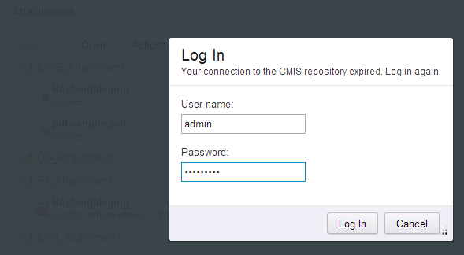
Using external documents as Attachments
When the user clicks on the attachment, if it is from an external repository, a Content Navigator log in dialog pops up
Notes:
Is the changed text accurate?

Slide 29
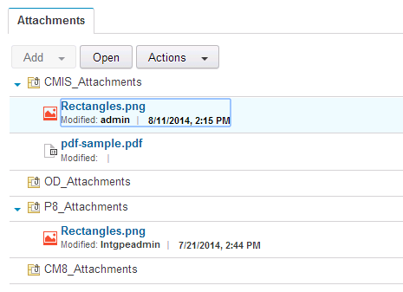
Using external documents as Attachments
After successful log in, all the attributes of the external attachment is retrieved and UI is updated
Notes:
Having logged in once, if I try to access another document from that repository will I be prompted to log on a second time? And can I avoid all these log on dialogs by configuring SSO?

Slide 30
Course Roadmap
  External Documents Overview
    Configuring and using external repositories
    Enabling external repositories using Case Builder
  Adding external documents to a Case
  Working with external documents in a Case
  Using external documents as Attachments
  Known issues and trouble shooting guidelines
  Course Summary

Slide 31
Known issues and trouble shooting guidelines
If an external document is deleted in its original repository after being added to a case, the document cannot be unfiled/removed from Case using the Case Client. In such cases, the proxy document will continue to show up until it is deleted from the TOS using tools such as FileNet Enterprise Manager (FEM).
Documents from Alfresco CMIS repositories do not support Cancel Checkout operation from Case Client.
If you run into issues and cannot work with an external document in a case folder, validate that IBM Content Navigator is able to connect to the repository and find the document.
User will have to make extra click on external attachment to enable all supported actions in context menu.

Slide 32
Course Summary
You have completed this course and can:
Understand how to work with documents from external repositories and add them to a case or as an attachment to a work item.

Slide 33
Contacts
Product Marketing Manager: William (Doc) Mills (wdocmills@us.ibm.com)
Product Manager: Dave Perman (dperman@ca.ibm.com)
Subject Matter Experts (SME)/Area of Expertise:
  Anu Shenoy (shenoya@us.ibm.com)
  Eugene Rozhdestvensky(eugener@ca.ibm.com)
Support: Ted Dullanty (tdullanty@us.ibm.com)

Slide 34
Product Help/Documentation/Resources
IBM Case Manager 5.2.1 Knowledge Center: http://www-01.ibm.com/support/knowledgecenter/SSCTJ4_5.2.1/com.ibm.casemgmttoc.doc/casemanager_5.2.1.htm
IBM Content Navigator 2.0.3 Knowledge Center: http://www-01.ibm.com/support/knowledgecenter/SSEUEX_2.0.3/contentnavigator_2.0.3.htm
IBM FileNet P8 5.2 Knowledge Center: http://www-01.ibm.com/support/knowledgecenter/SSNW2F_5.2.0/com.ibm.p8toc.doc/filenetcontentmanager_5.2.0.htm?lang=en
IBM Support: Fix Central http://www-933.ibm.com/support/fixcentral/

